Slide 1
ASSETS: Cloud Computing Project Summary
Project Overview
Technical Approach
With their stated intentions to migrate data processing to cloud computing architectures such as IC-ITE, continued viability with our customers requires that we develop tools and approaches to operate in the cloud environment.
The Cloud Computing Data Processing IRAD will take advantage of components, such as EC2, RDS, EMR, and Lambda, provided by cloud computing services for resource allocation
The goal is to create an engine and a framework that will facilitate the addition and integration of processing modules for data analysis and dissemination
The end product will provide:
Graphical User Interface to configure the system and to manage components
All basic implementation to interact with the different components from the cloud provider
A set of API to quickly develop and integrate custom modules to be used on a system
An engine that will tie them together
Incorporation of other processing frameworks such as NiFi
We propose implementing this IRAD on AWS. We think this approach is reasonable because of some important government implementations of IC-ITE, such as C2S and GovCloud, are built on AWS
Back-End Framework Development
Complete development of the back-end engine that will allow users to allocate resources to specific EC2 instances and to start/stop based upon task load.
Front-End GUI Development
Develop a front-end or GUI to allow users to manage modules as well as to command and control running threads
NiFi Integration
Integrate NiFi processing threads into CCDP to provide access to all available processors (on the order of hundreds).
Other Tools Integration
Incorporate processing technologies such as Machine Learning and Big Data by adding frameworks to the CCDP engine.
1
Notes:
07/29/17
1

Slide 2
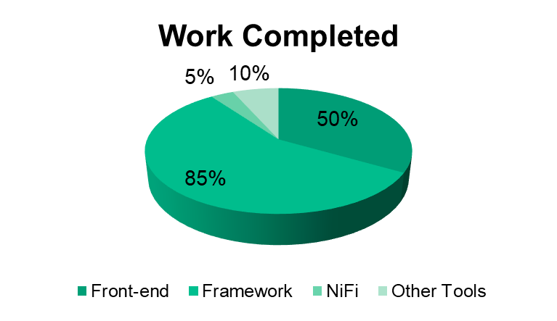
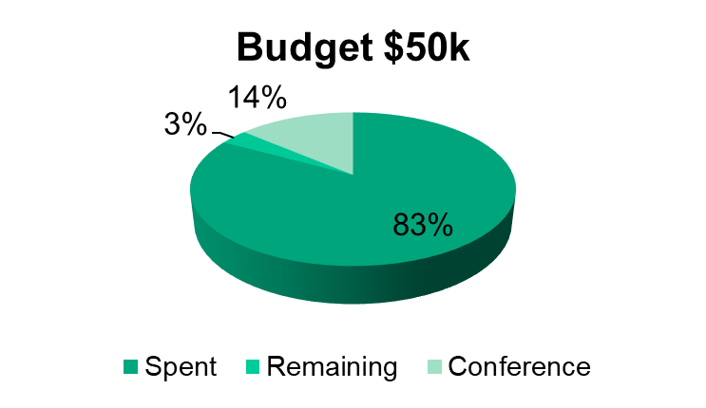
ASSETS: Cloud Computing Status
Accomplishements
Back-End Framework Development
Continue testing and improvements based on feedbacks from current projects running the framework.
Develop a more generic framework that does not require Mesos.
Implement additional interfaces to modify engine behavior
CCDP successfully deployed and use in 7 Hills
Front-End GUI Development
Added a front-end login page to command and control the NiFi Deployment
NiFi Integration
CCDP starts a new NiFi processing node after successful login.
More nodes are added to the session cluster as needed
All NiFi processing nodes are terminated after user logs out
Other Tools Integration
None.
AWS re-invent 2017
Registered to attend the AWS conference from 11/26 – 12/2

